Slide 1

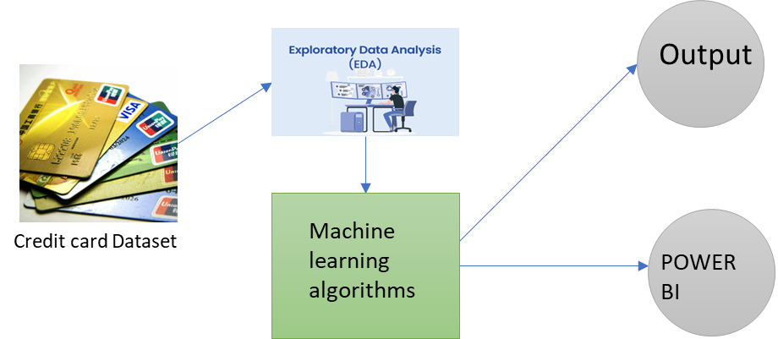
CREDIT CARD APPROVAL PREDECTION
Enrollment no:111
G. Rishitha – 2103A52016 M. Siri Chandana – 2103A52057
K. Mithra Sri – 2103A52050 T. Sai Teja – 2103A52035
INTRODUCTION
LIMITATIONS
. In Today’s digital world the financial sector is very influenced by advancements in technology .Credit card approval was traditionally relied more on manual assessments and subjective decision making. It requires a lot of time and manual labour and also is prone to many errors. In order to avoid these problems we have come up with this Project . This project involves prediction the credit card approval for each individual using a set of features . We have involved EDA ( exploratory Data Analysis ) to get more efficient , accurate and data driven approaches .Machine learning algorithms to find patterns in data amd PowerBI to visualize the predicts . , enabling stakeholders to gain actionable insights from the data and make informed decisions
, Traditional methods of processing credit card applications often involve manual assessment, leading to inefficiencies, delays, and subjective decisions.
Additionally, manual processes can be prone to errors and inconsistencies, resulting in suboptimal outcomes for both applicants and financial institutions.
EDA (Exploratory Data Analysis): One limitation is that EDA alone may not provide a complete understanding of the underlying patterns in the data. It is important to combine it with other techniques for more accurate predictions. While PowerBI is a powerful tool for data visualization, it does have limitations in terms of advanced analytics and model building. It is more suitable for presenting insights rather than performing complex modeling tasks.
PROBLEM STATEMENT
PROPOSED METHODOLOGY
The proposed methodology for credit card approval prediction starts with collecting the data set and the preprocessing using exploratory data analysis . Using Power BI for data visualization . Feature Engineering is done on data set to improve the performance of model . We used several machine learning algorithms like decision tree , random forest ,SVM, logistic regression to find out accuracy . Finally trained models are deployed for a real – time monitoring .
MODELS USED
We are employing a machine learning approach using logistic regression , Random forest , Decision Tree , SVM(support vector machine ) and Neural Networks approach to predict accuracy , f1-score , precision and support , We use EDA(Exploratory Data Analysis ) to clean the data , to check null values and missing values and to check the relation between coefficients .
RESULTS AND CONCLUSION
Overall Accuracy Analysis:
Logistic Regression Accuracy: 0.9999543139091304 Random Forest Accuracy: 1.0 Decision Tree Accuracy: 1.0 Deep Learning Accuracy: 1.0 Mean Squared Error for Deep Learning: 0.0
Neural Network Accuracy: 0.7380359549535144
REFERENCES
Khan, A., & Ghosh, S. K. (2021). Machine Assistance for Credit Card Approval? Random Wheel can Recommend and Explain. arXiv preprint arXiv:2105.06255.
Janapareddy, D., & Yenduri, N. C. (2023). Credit Card Approval Prediction: A comparative analysis between logistic regressionclassifier, random forest classifier, support vectorclassifier with ensemble bagging classifier
.
ACKNOWLEDGEMENT
Dr.M.Sheshikala, HOD, CSAI Dept.
PROJECT GUIDE – Mrs.G.Neelima, Asst Prof.,
CSAI Dept
CO-ORDINATOR – P.Praveen ,Prof.,CSAI Dept

